Slide 1
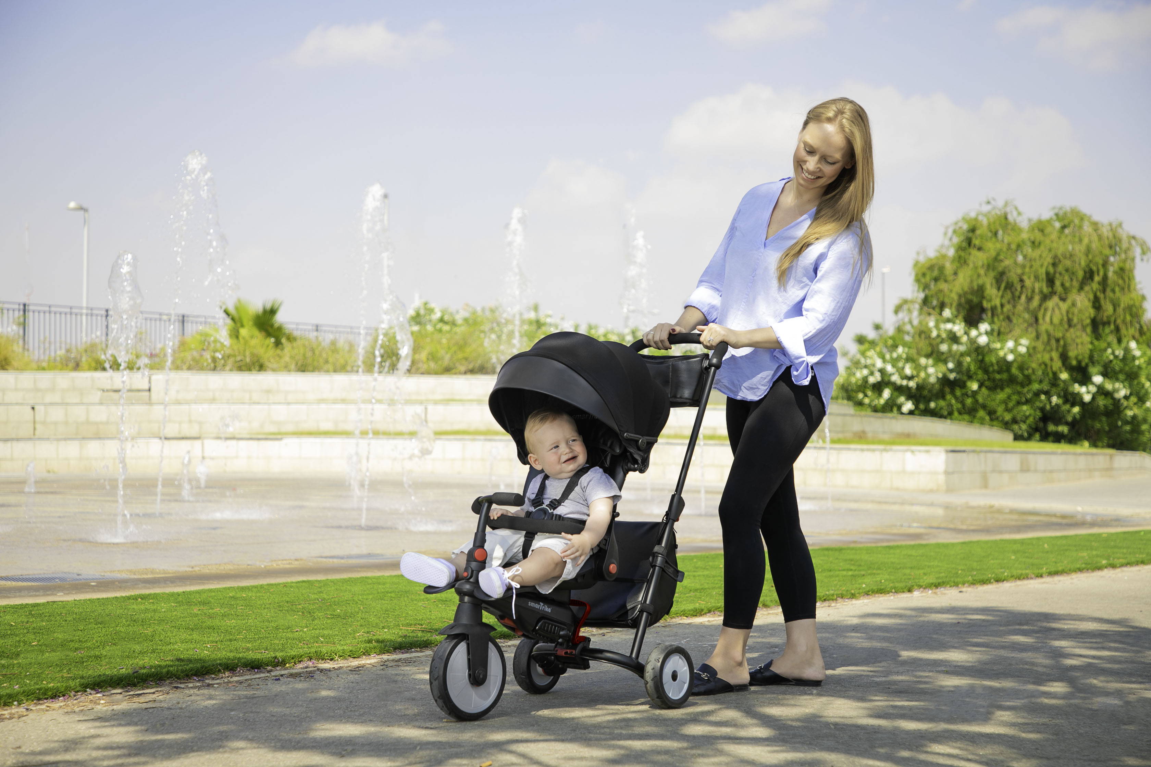
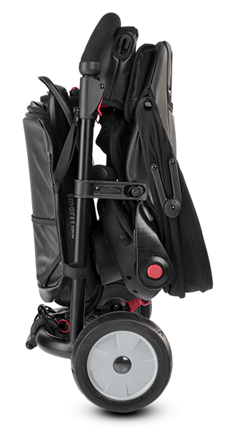






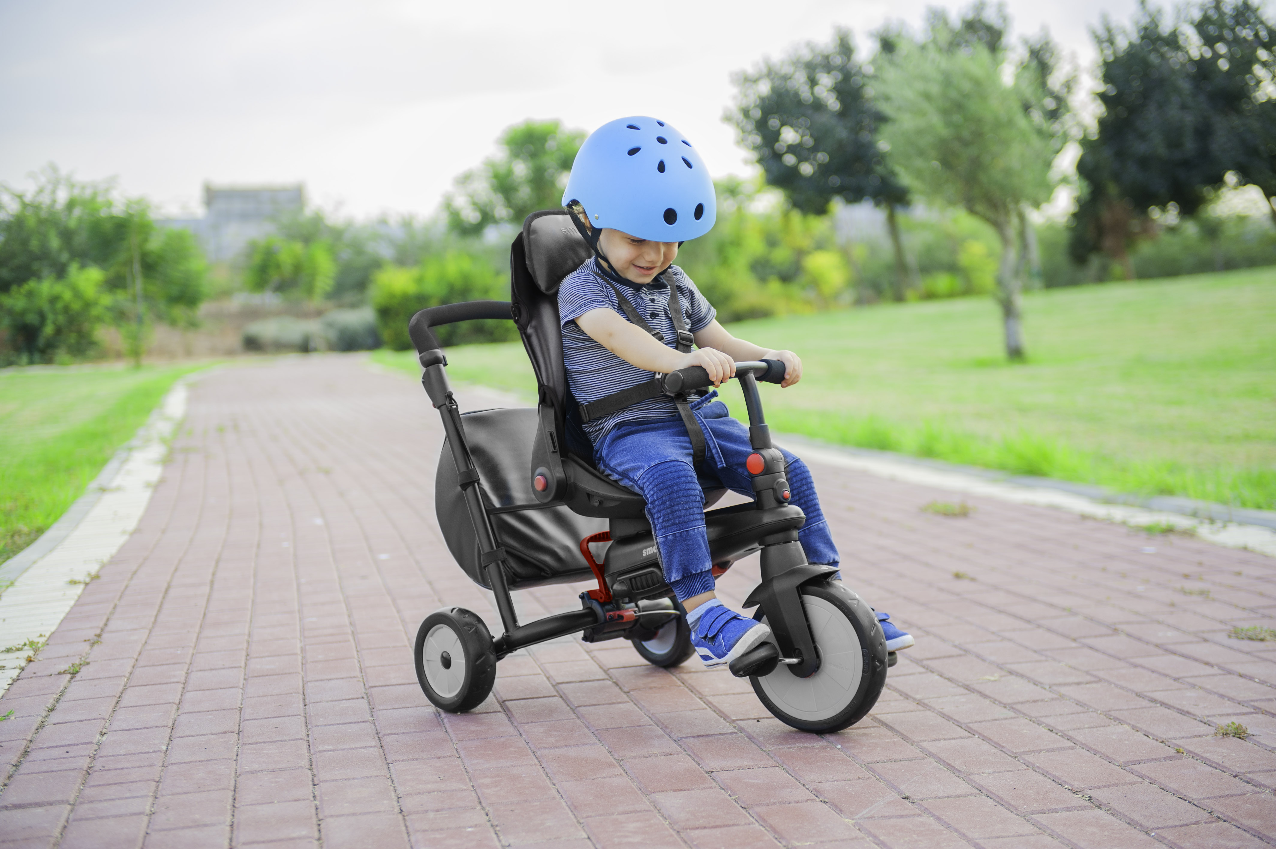

STR7 Urban
Folding Baby Tricycle 7 in 1
6 M +
5501100
No tools assembly
Easily switch between parent & child control
Stroller Certified
Advanced brake system
Reclining seat for naptime
Patented shock absorbers for a smooth ride
Extendable canopy - detachable
Compact folding
The STR™ 7 Urban 7 in 1 trike is a fully folding baby tricycle with stroller standards. It is designed to grow with your baby in 7 stages from 6-36 months, and folds up compactly to make travelling easier.
Ultra fashionable in a modern urban look, this trike goes from a baby push tricycle with a reclining seat, to an independent toddler tricycle that helps them develop the skills needed for independent riding.
Safety features ensure a worry and stress-free ride for all. 5-point safety harness, advanced brake system, patented Touch Steering® and Shock Absorbers® are installed to allow you and your baby to enjoy the ride.

Slide 2
Long description:
The STR7 Urban 7 in 1 trike is a fully folding baby tricycle with stroller standards. Ultra fashionable in a modern urban look, it is designed to grow with your baby from 6-36 months, and folds up compactly, making it the ideal travel choice for families.
Our Touch Steering® patent gives the parent effortless manoeuvring control over the toddler trike: lightly touch the parent handle and the push tricycle intuitively steers in the right direction.
The STR7 Urban baby tricycle features a reclining seat so your baby can sit upright or nap comfortably on-the-go. It has a full padded seat cover for optimal comfort that can be removed and washed when needed.
Packed with safety features, the toddler trike ensures a worry and stress-free ride for all. Featuring a parent-controlled brake system, an adjustable 5-point harness and a safety bar to keep your baby securely buckled in.
Super convenient for parents and fun for babies! This trike grows with your baby in 7 stages from a baby push tricycle to an independent toddler tricycle, helping them develop the motor skills, confidence and balance needed for independent riding.
Decide who controls the trike. Once old enough, you and your baby can enjoy the dual control function. Easily give control of the trike to your baby, or switch it back into a push tricycle when they are tired or getting frustrated.
Enjoy a smooth and comfortable ride with patented shock absorbers and durable, puncture-free EVA wheels.
This tricycle is easy to assemble with no tools needed.
Stage 1: Folds Compactly. Store conveniently, or wheel around with the extendable parent handle for easy transportation.
Stage 2 (6M+): Reclining seat. Your baby enjoys a comfortable ride with a cozy, padded seat cover and a reclining seat, making naptime on-the-go convenient for everyone.
Stage 3 (6M+): Comfort & Fun. Baby enjoys a comfortable ride seated upright, with extendable canopy, 5-point harness, safety bar and young baby footrest.
Stage 4 (12M+): Supporting Posture. Remove the young baby footrest. Unfold the toddler footrest allowing baby to sit more upright while resting their feet in a downward position.
Stage 5 (18M+): Develops Valuable Skills. Remove the canopy and watch baby build balance, curiosity and confidence, while enjoying a fun ride and wide-eyed view.
Stage 6 (24M+): Teaches Pedaling. Close the footrest, remove the safety bar, attach the pedals and use the Control Button to switch between parent & child control. Build motor skills while learning to ride.
Stage 7 (30-36M+): Supports Independence. Close the parent handle. The high back support and 5-point harness keep toddler secure while they pedal happily on their own and become little adventurers.
Micro-description (up to 50 words):
Make travelling easier with our compact folding, stroller-standard trike. Features: Sun canopy, padded seat cover & storage bag. World patented shock absorbers and intuitive Touch Steering® system for effortless maneuvering. Easy transfer from parent to child control. 2 footrests. No tools needed for assembly. Age: 6-36 months.

Slide 3
Bullet points:
Key Features
Compact & fully folding
Easy Touch Steering®
Reclining seat for naptime
Patented shock absorbers for a smooth ride
Easily switch between parent & child control
2-Stage training pedals – non-slip & removable
Safety
Adjustable 5-point harness
Advanced brake system
Foam covered baby safety bar
Extendable canopy - detachable
Meets safety requirements
Stroller Certified
Added Value
High back support
Padded seat cover – removable & washable
EVA wheels – quiet & no punctures
Foldable toddler footrest
Storage bag for baby essentials
Keywords:
baby tricycle, kids tricycles, push tricycle, smart trike, smarTrike, toddler tricycle, toddler trike, tricycle, tricycle for 1 year old, tricycle for 2 year old, tricycle for kids, tricycles, tricycles for 2 year olds, trike, baby trike, tricycle with push handle

