Slide 1
XtendTouch XT1310F
Introduction presentation
Rev 1.0, March 2020

Slide 2
About Pepper Jobs
Founded in 2017 by a group of customer-focused gadget enthusiasts and engineers, Pepper Jobs aims to become one of the world's leading computing and mobile gadgets companies.
To achieve this goal, Pepper Jobs has been developing a wide variety of innovative gadgets with cutting-edge technologies, premium quality and delivering them to our customers at an affordable cost. Through these products, Pepper Jobs strives to unparalleled satisfaction and reliability to consumers.
Our range of product offerings include mini computers, smart remote controllers, digital signage players, USB-C multiport adapters, USB-C chargers, USB-C cables and portable displays.
XtendTouch XT1310F is a new portable screen designed and released by Pepper Jobs targeting mobile entertainment and mobile productivity tasks.

Slide 3
What does XtendTouch mean
Extend Anywhere, Touch on the Go

Slide 4
Major issues found in other solutions
Lack of HDCP key
Poor Compatibility
Chaotic button definition
No speaker/ poor speaker quality
Poor build quality
Let’s improve it!

Slide 5
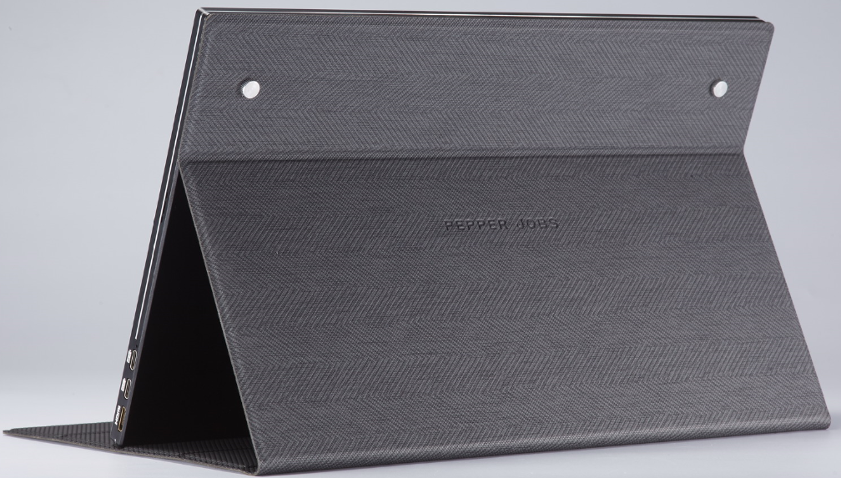
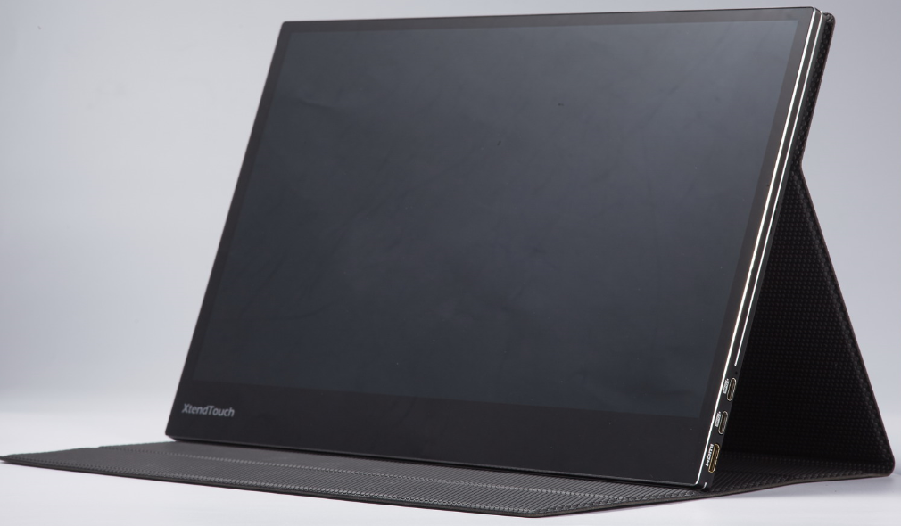
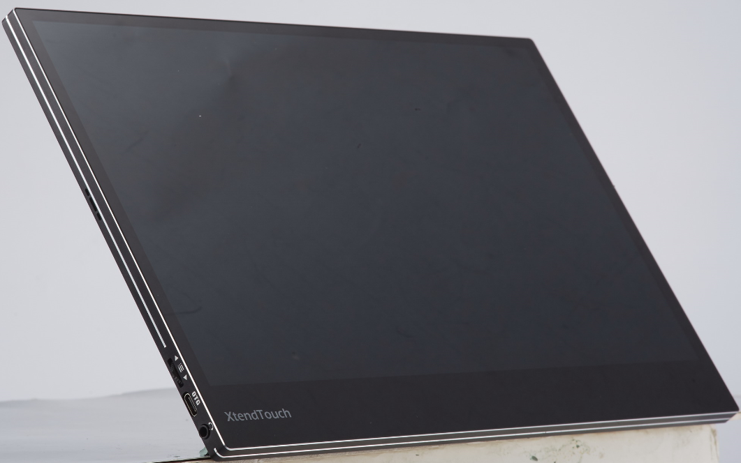
Overview

Slide 6
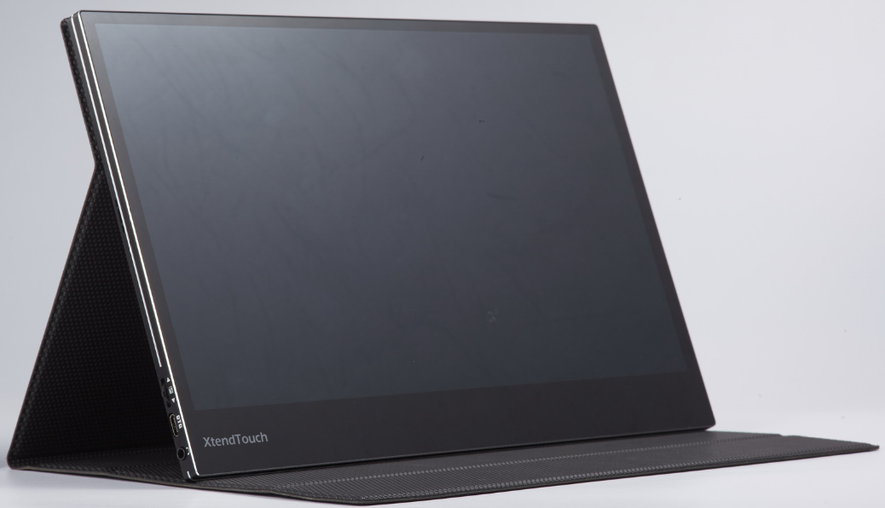
Technical Specifications
Panel: 13.3’’ IPS
Size: 307.1 x 197.0 x 9.9 mm
Weight: 740g(without cover)/965g(with cover)
Resolution: 1920 x 1080P @ 60Hz max.
Luminance: 300 cd/m², LED backlit
Contrast: 800:1
Color Gamut: 72% NTSC
Digital Input: USB-C x 2 (DP-ALT mode), mini HDMI
Power Input: 5V/1A min
Viewing Angel: 85/85/85/85 (Typ.)
Touch: Yes, 10-Point capacitive touch
Interface: USB-C x 2, OTG Port x 1, Mini HDMI x 1，3.5mm audio jack
Speakers: 2
Surface Color: Black + Silver
Compatible OS: Windows, Linux, macOS, Chrome OS, Android etc.
Certification: RoHS, CE, FCC, PSE ,etc.

Slide 7
Key features of XtendTouch XT1310F
13.3” IPS panel
Dual video inputs (USB-C & mini-HDMI)
Dual USB-C blind insertion display & charging ports , PD passthrough
Dual-loudspeakers, surround stereo sound
10-point capacitive touch
One button & touchable OSD design
OTG port ready, supports wireless KB/MS, thumb drive, USB audio
Multi-OS supported (Windows 10, macOS, Android, Linux , ChromeOs )
Supports Nintendo Switch ( connected with original / over 45W adapter)
Compatible with both QC & PD fast charging protocols
HDCP key ready

Slide 8
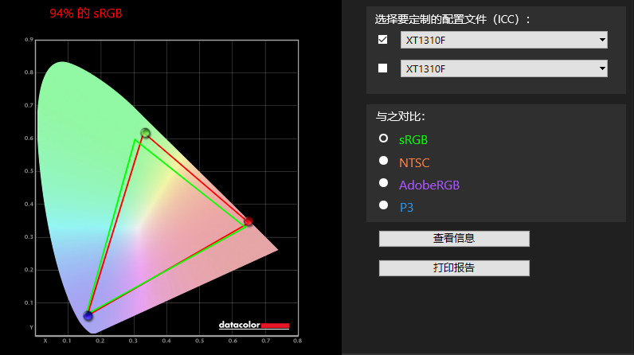
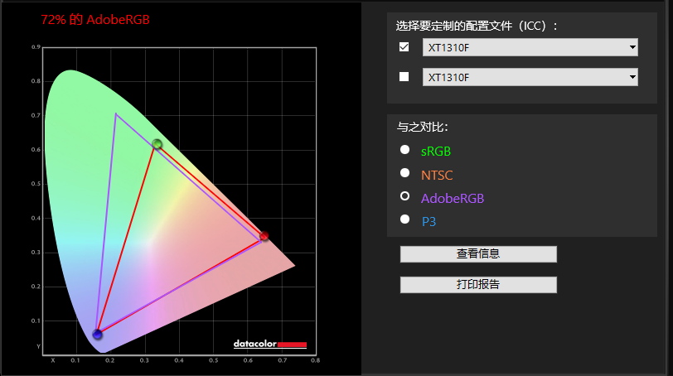
13.3” IPS panel, 72% AdobeRGB, 300 nit brightness
Great color display
Better brightness

Slide 9
Dual video inputs (USB-C & mini-HDMI)
2 inputs simultaneously
Dual USB-C blind insertion display & charging ports
PD passthrough
HDCP key pre-loaded
Mini HDMI
USB-C Display & Charging ports

Slide 10
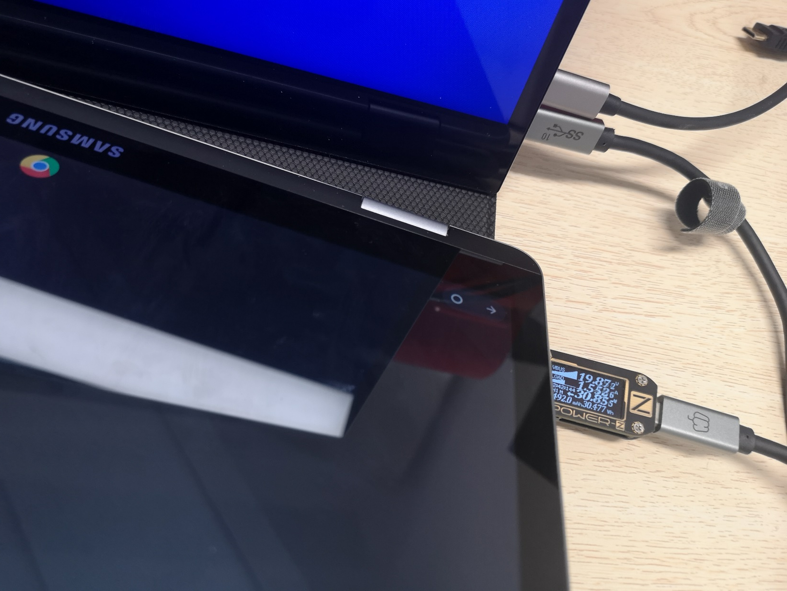
PD & QC fast charging passthrough
Screen drain 5V/1A min from the source device
PD & QC fast charging passthrough
Using and charging at the same time
No need to connect one more adapter for source device
PD/QC Input
PD/QC Output
PD/QC Input

Slide 11
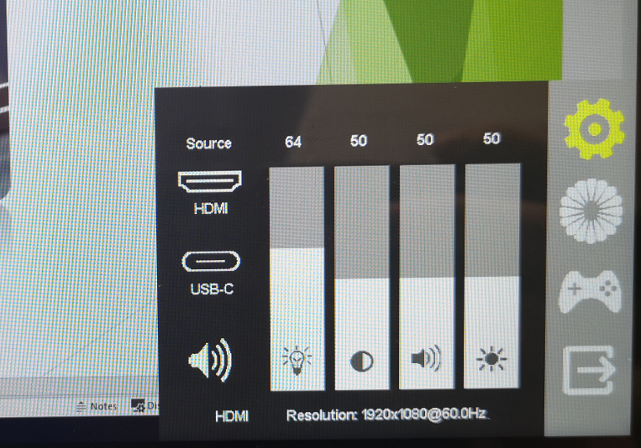
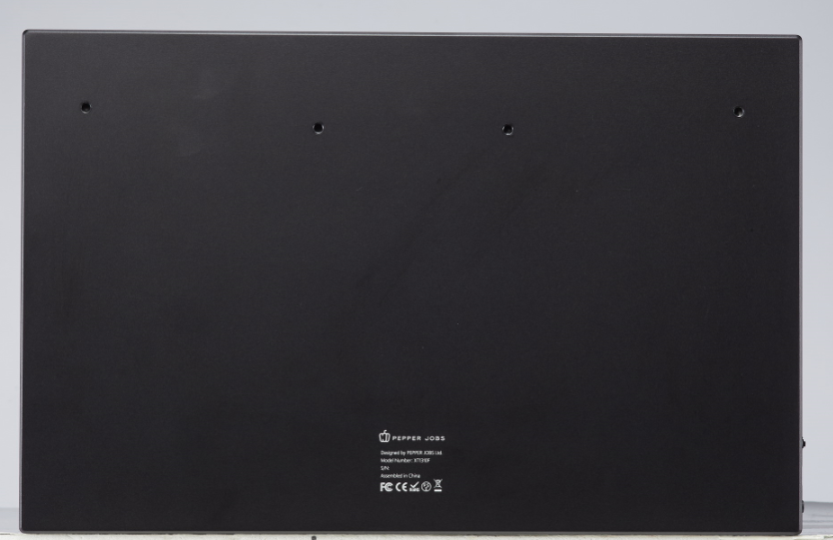
One button & touchable OSD design
One Thumb Wheel Key
Touchable OSD menu
No more chaotic button definition
VESA mount

Slide 12
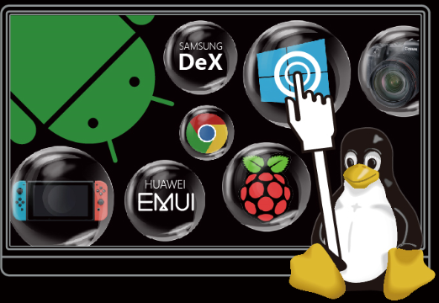
10-point capacitive touch
Accurate touch response, no jumping effect
Supports Windows 10, Android, macOS, Linux Oses ,Chromeos
* macOS – Simple drag and click action are supported in macOS Mojave, not in macOS Catalina
Switch – No Touch support

Slide 13
OTG port
Supports wireless KB/MS receiver
Supports thumb drive
Supports USB audio
Essential for mobile desktop mode applications (DeX, EMUI, Android 10)

Slide 14
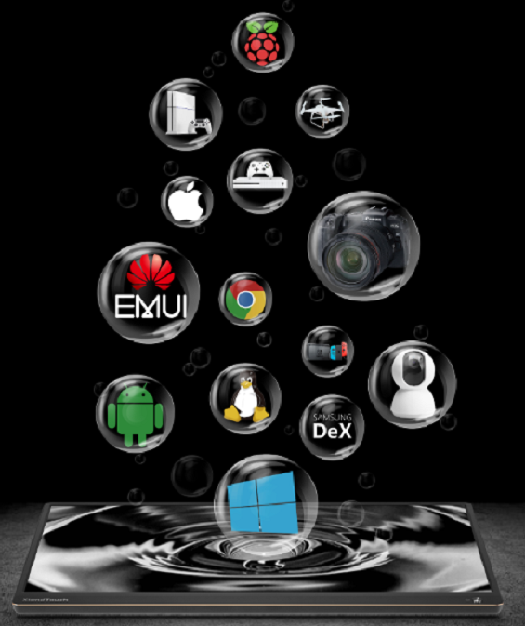
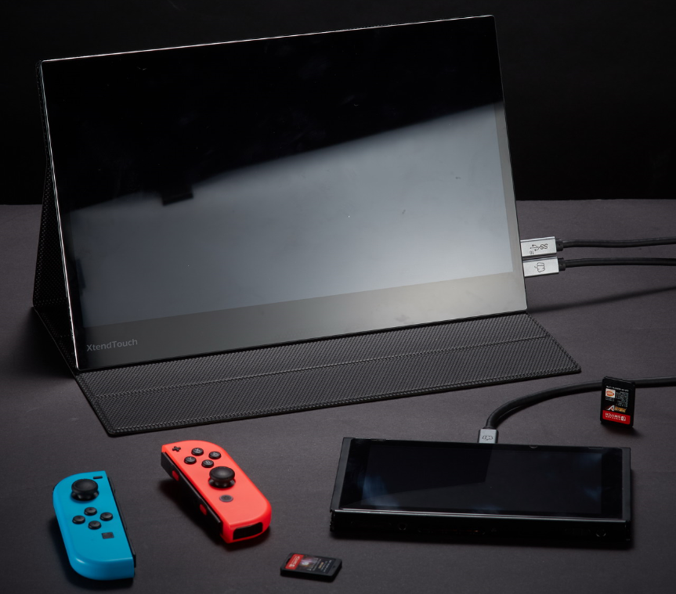
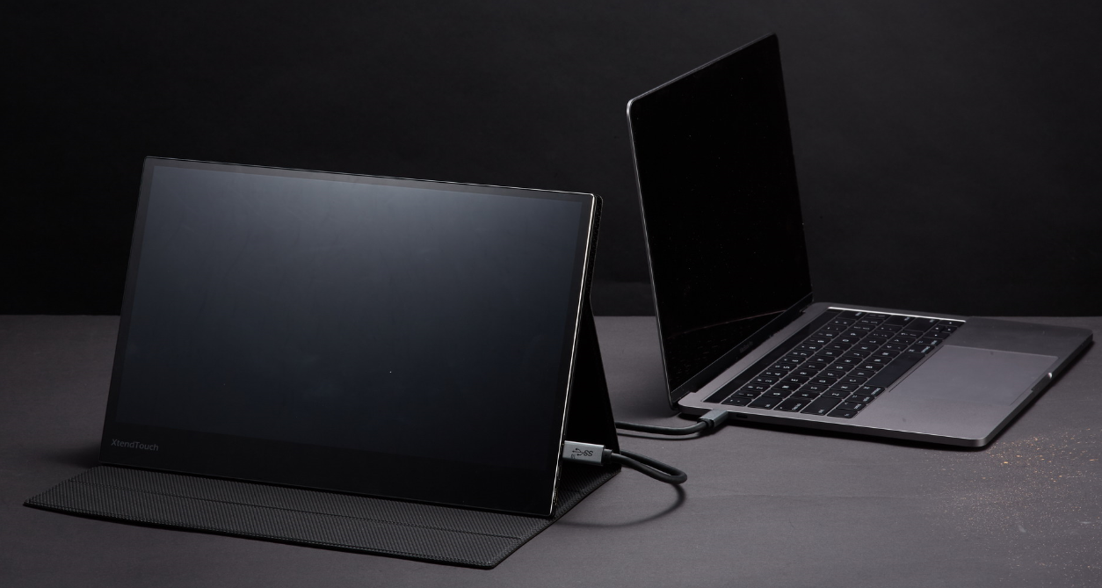
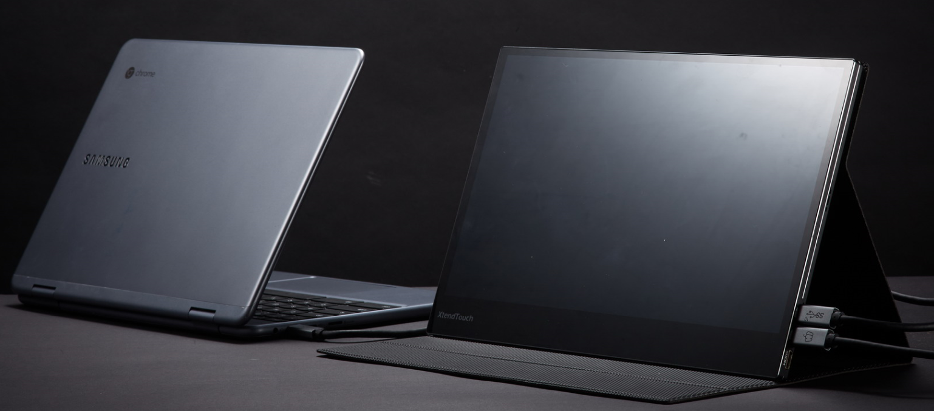
Multi-OS support
Supports Windows 10, *MacOS, Android, Linux
Supports *Nintendo Switch
* macOS – Simple drag and click action are supported in macOS Mojave, not in macOS Catalina
Switch – No Touch support

Slide 15
What’s inside the package
XtendTouch XT1310F
Smart cover (stand)
Quick User Guide
OTG to USB-A female cable
HDMI to mini HDMI cable
USB-C 3.1 Gen 2 10Gbps cable (support charging up to 20V/5A, 100W)
Thanks card

Slide 16
Thank you!!

