Slide 1
Philips HeartStart FRx AED
June 2021

Slide 2
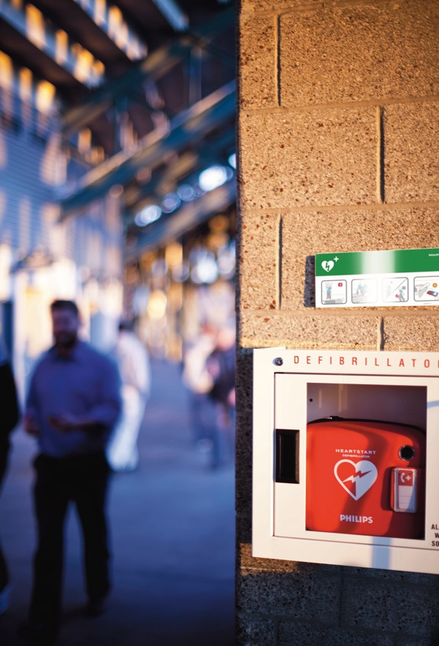
To help save a life
Cardiovascular disease is a leading cause of global mortality, accounting for almost 17 million deaths annually, or 30% of all global mortality.¹
For basic life support (BLS) trained responders, there’s nothing more important than saving lives. When the need arises, it is important to quickly and confidently assess many unknowns.
• What is the patient’s condition?
• What is the environment like?
• What is the treatment protocol?
It is crucial that automated external defibrillators (AEDs) be close at hand, ready to go, designed to be easy to use, lightweight and rugged.
1. Mehra R. Global public health problems of sudden cardiac death. Journal of Electrocardiology. 2007;40(6 Suppl);S118–122. DOI: 10.1016/jelectrocard.2007.06.023.

Slide 3
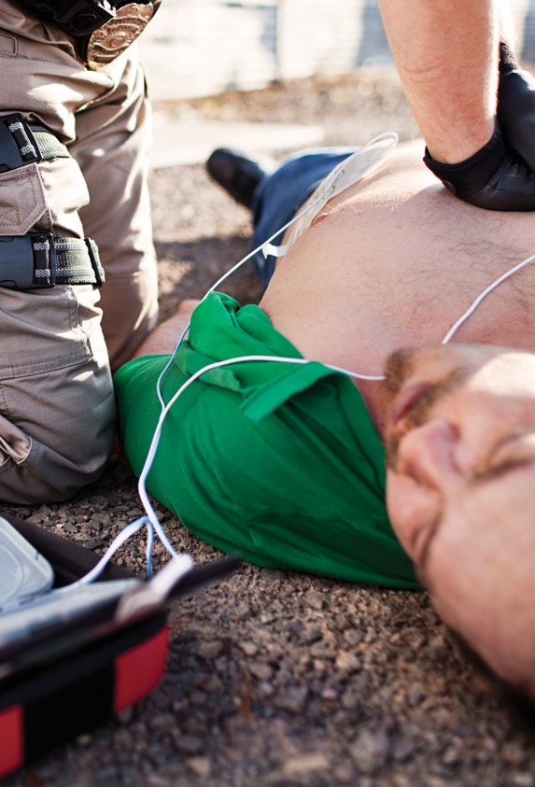
Every minute counts when it comes to saving lives
The survival rate from sudden cardiac arrest (SCA) is less than 1% worldwide and close to 5% in the United States.² More than half the victims of the most common cause of SCA can survive when treated with CPR and shock from a defibrillator within three to five minutes of collapse.³
The Philips HeartStart FRx AED guides you through a cardiac emergency with a simple, step-by-step process, adaptive instructions and intelligent sensors to help deliver therapy.
Philips AED Solutions are designed for ease of use and reliability, with practical, real-time voice guidance – all brought to you by Philips, the trusted global leader in emergency care resuscitation.
2. Mehra R. Global public health problems of sudden cardiac death. Journal of Electrocardiology. 2007;40(6 Suppl):S118–122. DOI: 10.1016/j.electrocard.2007.06.023.
3. Koster RW, Baubin MA, Bossaert LL, et al. European Resuscitation Council Guidelines for Resuscitation 2010: Section 2. Adult basic life support and use of automated external defibrillators. Resuscitation. 2010;81(10):1277-1292.

Slide 4
Philips AED Solutions partners with you in the shared mission of helping to save lives.
Side by side. Step by step.
Philips HeartStart FRx defibrillator

Slide 5
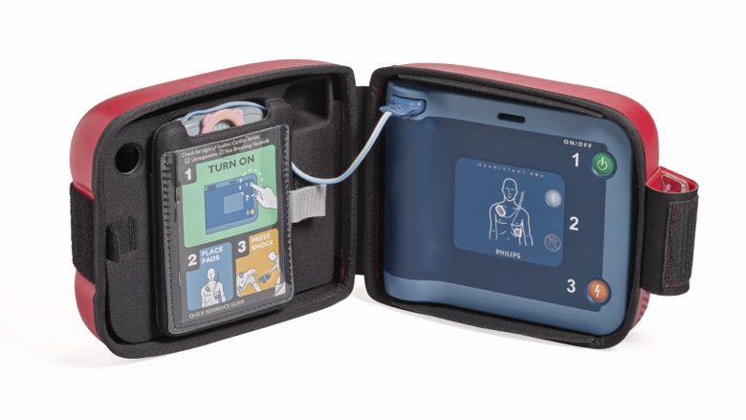
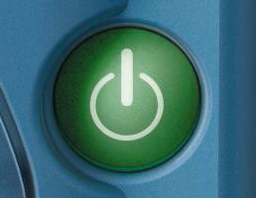
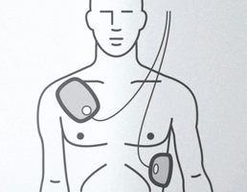
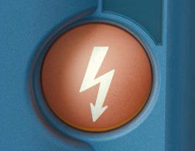
Easy as 1-2-3
1
Pull the handle on the Cartridge Cover and press the green On/Off button, which activates voice instruction and visual icons
2
Place the pads on the patient as directed
3
When advised by the device, press the orange Shock button
Patented Quick Shock feature allows FRx to typically deliver a shock within eight seconds after CPR.⁴
4. Nichol G, Sayre MR, Guerra F, Poole J. Defibrillation for Ventricular Fibrillation: A Shocking Update. Journal of American College of Cardiology. 2017:70(12):1496–1509. DOI: 10.1016/j.jacc.2017.07.778.

Slide 6
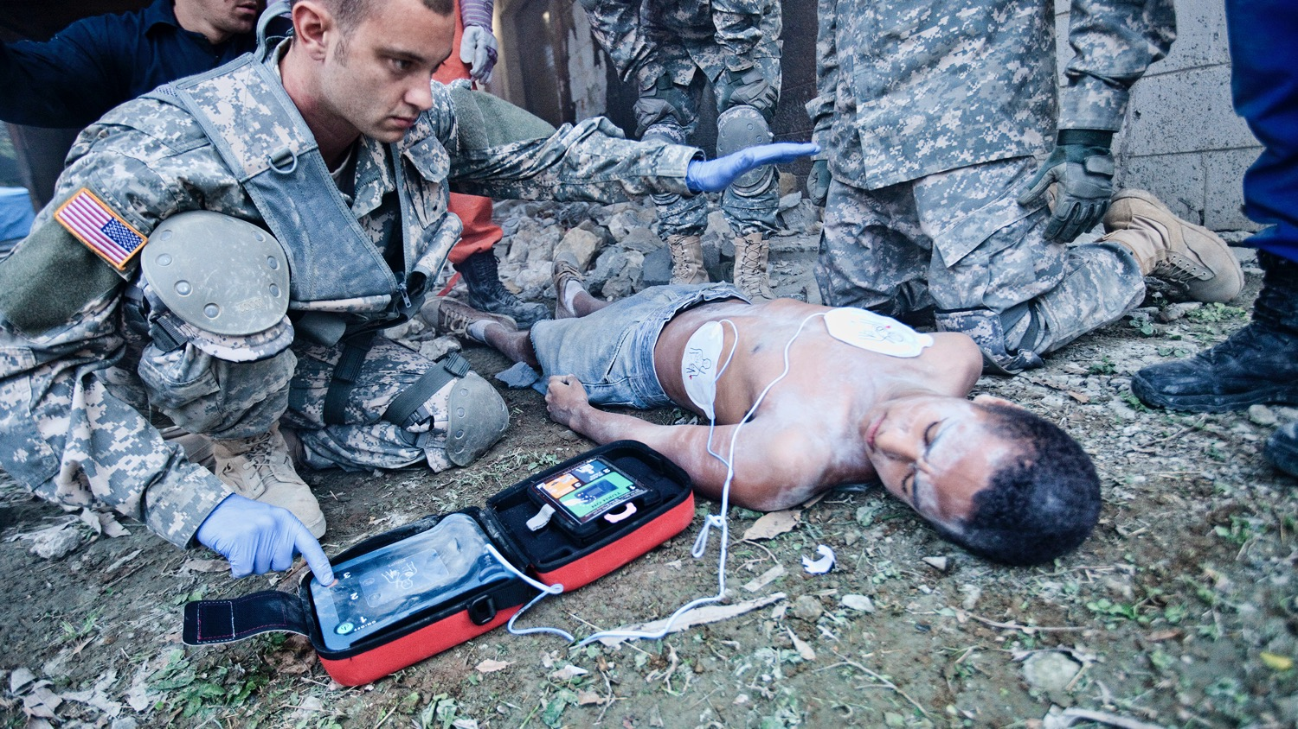
Designed to work where you need it
Lightweight, rugged and reliable, the FRx defibrillator can withstand rough handling, extreme temperatures, and dusty or wet surfaces. Designed for use in harsh settings, it can withstand up to 500 kg (1,100 lb) and drops from 1.2 m (4 ft).

Slide 7
Easy to use
Pre-connected SMART Pads II can be used for both adults and children. Once installed and activated, the FRx is easy to maintain. It performs a series of automatic self-tests – daily, weekly and monthly – to check pad readiness and verify functionality and calibration of circuits and systems. It can last up to four years between battery replacements.

Slide 8
Patented technology. Proven therapy.
Simple step-by-step instructions and voice commands are paced to your actions, and an audible metronome and CPR guidance assist the responder. When treating an infant or child, simply insert the optional infant and child key and the FRx adjusts instructions and therapy.

Slide 9
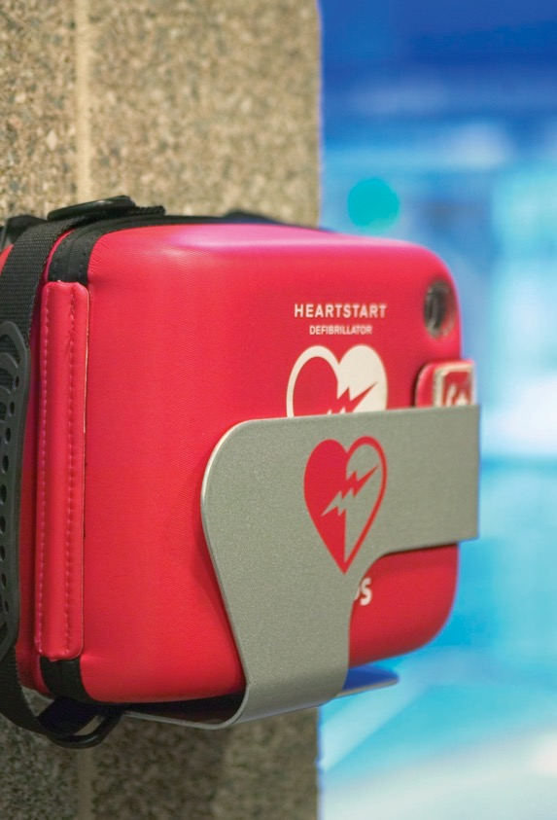
Expert guidance
The Philips HeartStart FRx defibrillator features intuitive, step-by-step voice instructions, including CPR guidance, and an audible metronome to help guide trained responders while treating a suspected cardiac arrest.
Includes features to help guide the treatment of SCA with easy setup, audible metronome and clear, step-by-step voice commands paced to your action
Provides CPR instructions for infants and children under 25 kg (55 lb) or 0-8 years old and adults and children over 25 kg (55 lb) or greater than 8 years old
Has an optional infant and child key; simply insert it and the defibrillator adjusts instruction and therapy, eliminating the need for additional infant and child pads
Includes pre-connected SMART Pads II that can be used for both adults and children; SMART Analysis automatically assesses heart rhythm and only delivers a shock if the victim’s rhythm is determined to be treatable by the Philips advanced algorithm, even if the Shock button is pressed
Provides adaptive instructions and intelligent sensors to help deliver therapy
Performs a series of automatic self-tests – daily, weekly and monthly – to check pad readiness and verify functionality and calibration of circuits and systems
Features eight realistic SCA scenarios; simply insert the Training Pads II (available separately) to temporarily disable the FRx’s energy delivery capability and the defibrillator will switch into training mode
Results from case studies are not predictive of results in other cases. Results in other cases may vary.

Slide 10
When every minute counts, Philips AED Solutions are
a partner by your side.
With expert guidance and support, Philips AED Solutions are here when you need us most. Side by side. Step by step.

Slide 11
©2021 Koninklijke Philips N.V. All rights reserved. Specifications are subject to change without notice. Trademarks are the property of Koninklijke Philips N.V. or their respective owners.
4522 991 64091 * JUNE 2021

